Slide 1



MERN – ES6 + React
Module 03: CSS Basics

Slide 2
Outline
Module 03
CSS Basics
use “ids” to target single elements
use “classes” to target groups of elements
use combinations of selector tags to target certain combinations of elements

Slide 3
What is CSS?
CSS Introduction
CSS stands for Cascading Style Sheets
CSS is not a programming language. It's not a markup language either.
CSS is a style sheet language
CSS describes how HTML elements are to be displayed on screen, paper, or in other media
CSS saves a lot of work. It can control the layout of multiple web pages all at once

Slide 4
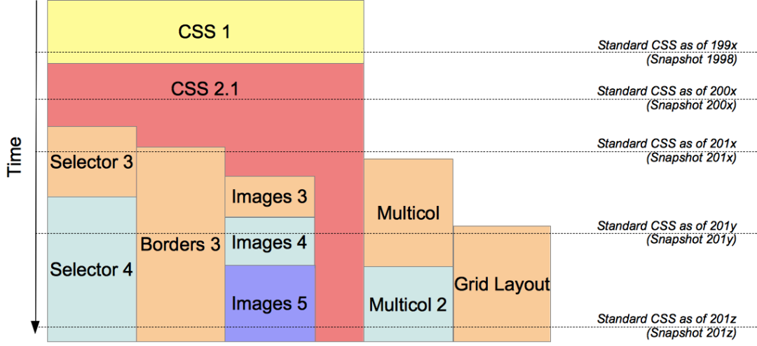
Evolution of CSS 3.0

Slide 5
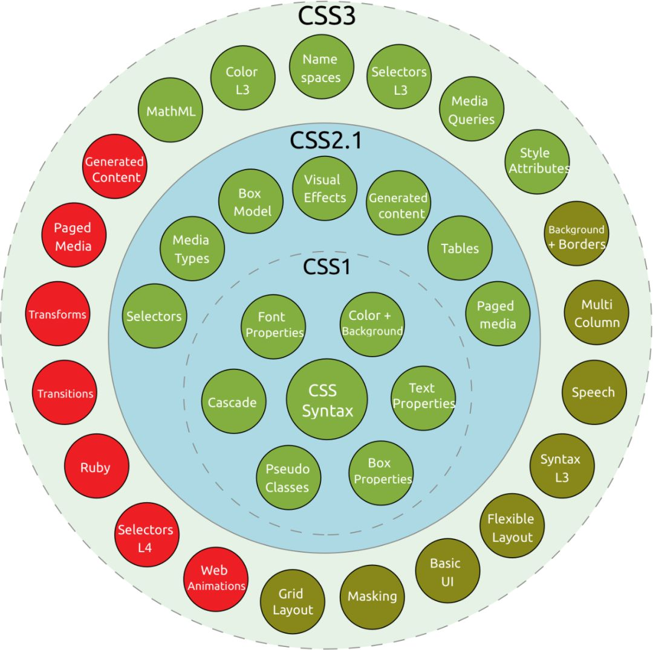
Evolution of CSS 3.0

Slide 6
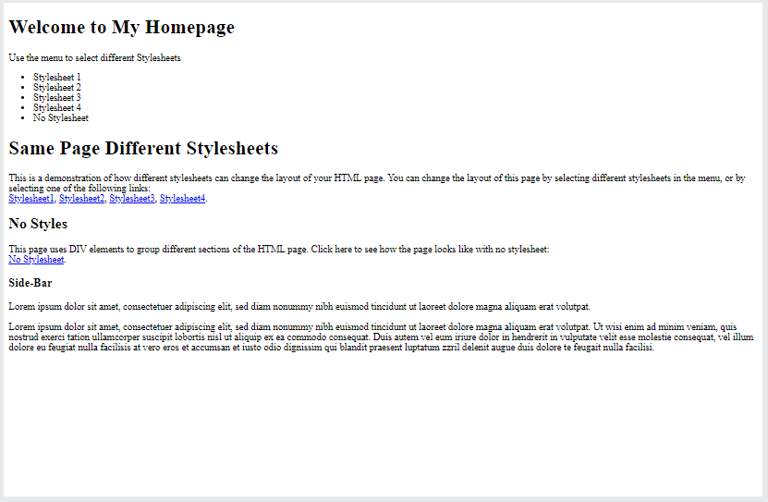
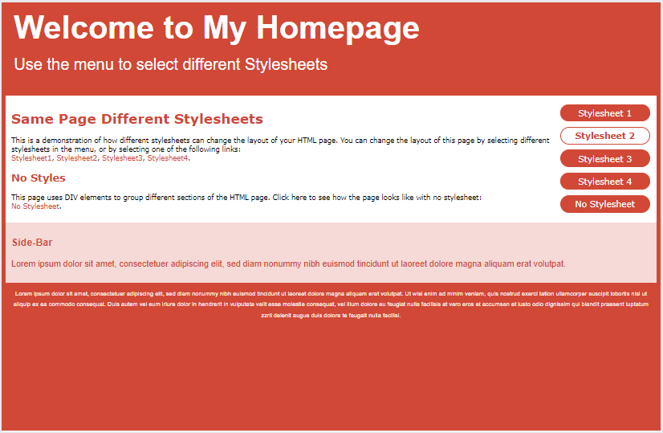
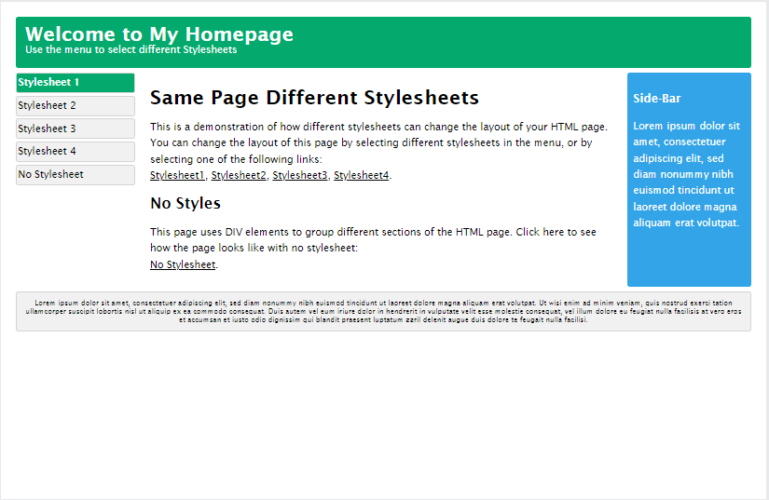
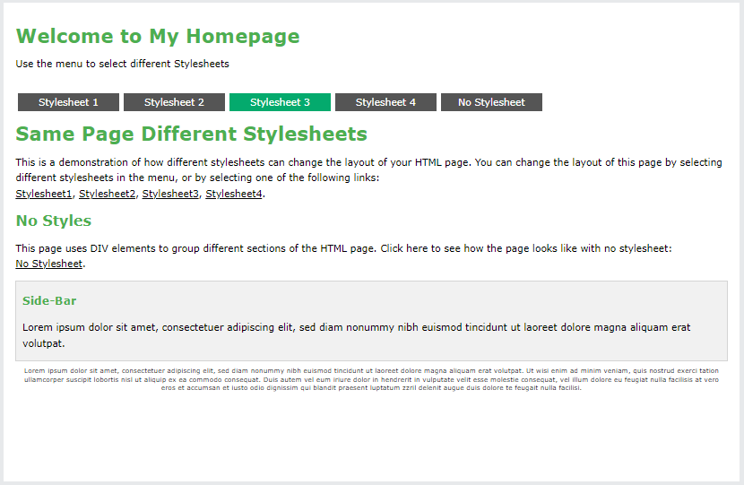

Slide 7
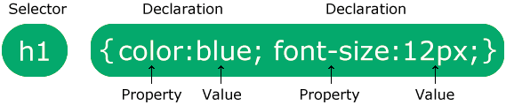
CSS Syntax
CSS Basics
A CSS rule consists of a selector and a declaration block.
The selector points to the HTML element you want to style.
The declaration block contains one or more style declarations separated by semicolons.
Each declaration includes a CSS property name and a value, separated by a colon.

Slide 8
CSS Selectors
A CSS selector selects the HTML element(s) you want to style.
CSS selectors are used to "find" (or select) the HTML elements you want to style.
We can divide CSS selectors into five categories:
Simple selectors (select elements based on name, id, class)
Combinator selectors (select elements based on a specific relationship between them)
Pseudo-class selectors (select elements based on a certain state)
Pseudo-elements selectors (select and style a part of an element)
Attribute selectors (select elements based on an attribute or attribute value)

Slide 9
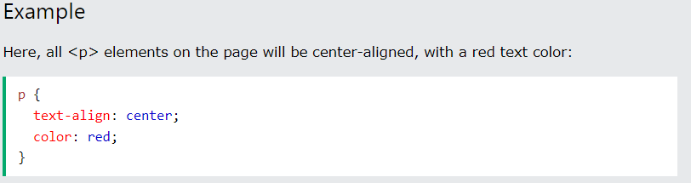
CSS Selectors
A CSS selector selects the HTML element(s) you want to style.
The CSS element Selector
The element selector selects HTML elements based on the element name.

Slide 10
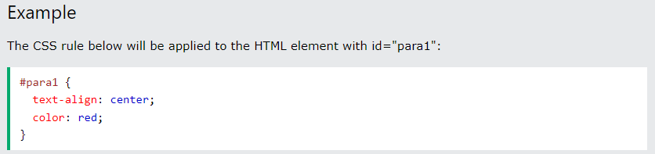
CSS Selectors
A CSS selector selects the HTML element(s) you want to style.
The CSS id Selector
The id selector uses the id attribute of an HTML element to select a specific element.
To select an element with a specific id, write a hash (#) character, followed by the id of the element.

Slide 11
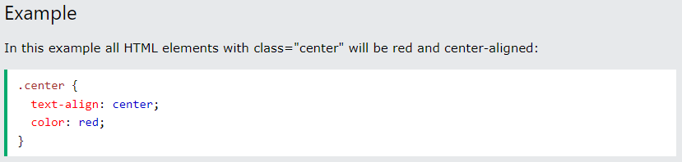
CSS Selectors
A CSS selector selects the HTML element(s) you want to style.
The CSS class Selector
The class selector selects HTML elements with a specific class attribute.
To select elements with a specific class, write a period (.) character, followed by the class name.

Slide 12
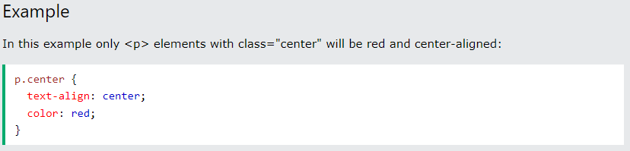
CSS Selectors
A CSS selector selects the HTML element(s) you want to style.
The CSS class Selector
The class selector selects HTML elements with a specific class attribute.
To select elements with a specific class, write a period (.) character, followed by the class name.
You can also specify that only specific HTML elements should be affected by a class.

Slide 13
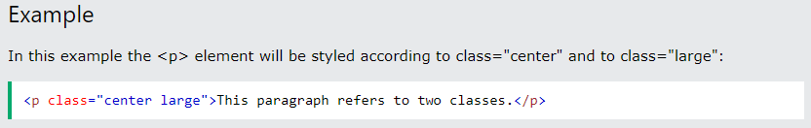
CSS Selectors
A CSS selector selects the HTML element(s) you want to style.
The CSS class Selector
The class selector selects HTML elements with a specific class attribute.
To select elements with a specific class, write a period (.) character, followed by the class name.
You can also specify that only specific HTML elements should be affected by a class.
HTML elements can also refer to more than one class.

Slide 14
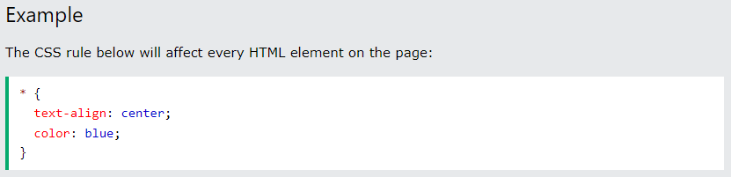
CSS Selectors
A CSS selector selects the HTML element(s) you want to style.
The CSS Universal Selector
The universal selector (*) selects all HTML elements on the page.

Slide 15
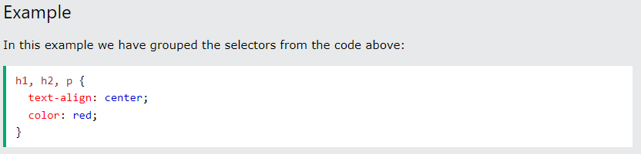
CSS Selectors
A CSS selector selects the HTML element(s) you want to style.
The CSS Grouping Selector
The grouping selector selects all the HTML elements with the same style definitions.
To group selectors, separate each selector with a comma.

Slide 16

How To Add CSS
Three Ways to Insert CSS
External CSS
Internal CSS
Inline CSS

Slide 17
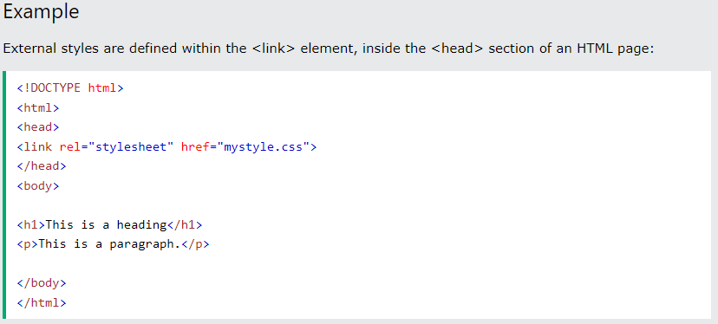
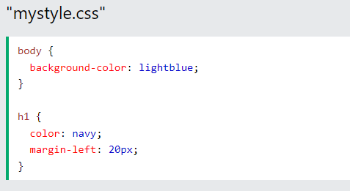
External CSS
With an external style sheet, you can change the look of an entire website by changing just one file!
Each HTML page must include a reference to the external style sheet file inside the <link> element, inside the head section.

Slide 18
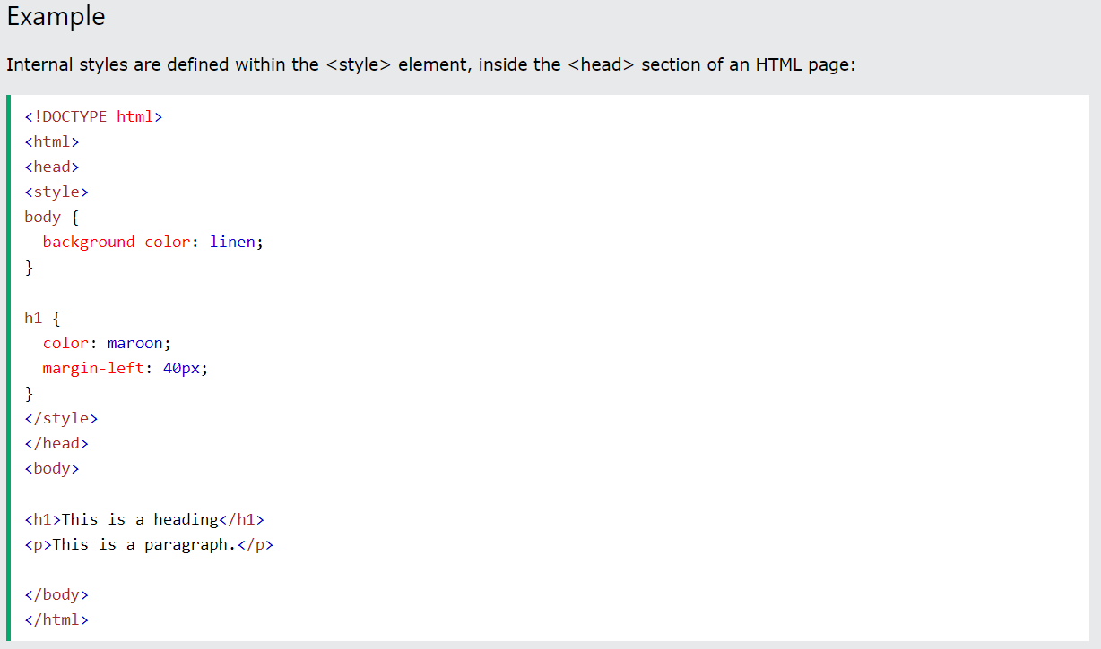
Internal CSS
An internal style sheet may be used if one single HTML page has a unique style.

Slide 19
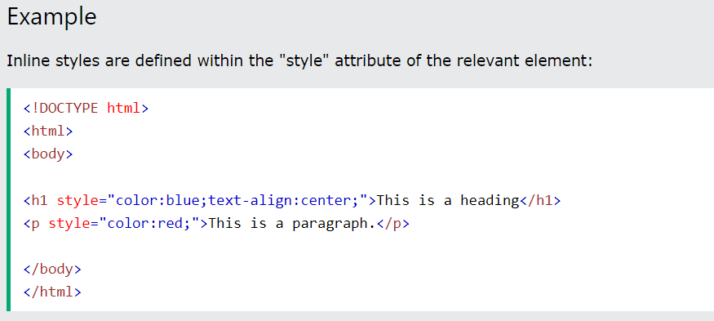
Inline CSS
An inline style may be used to apply a unique style for a single element.
To use inline styles, add the style attribute to the relevant element. The style attribute can contain any CSS property.

Slide 20
Cascading Order
What style will be used when there is more than one style specified for an HTML element?
All the styles in a page will "cascade" into a new "virtual" style sheet by the following rules, where number one has the highest priority:
Inline style (inside an HTML element)
External and internal style sheets (in the head section)
Browser default
So, an inline style has the highest priority, and will override external and internal styles and browser defaults.

Slide 21
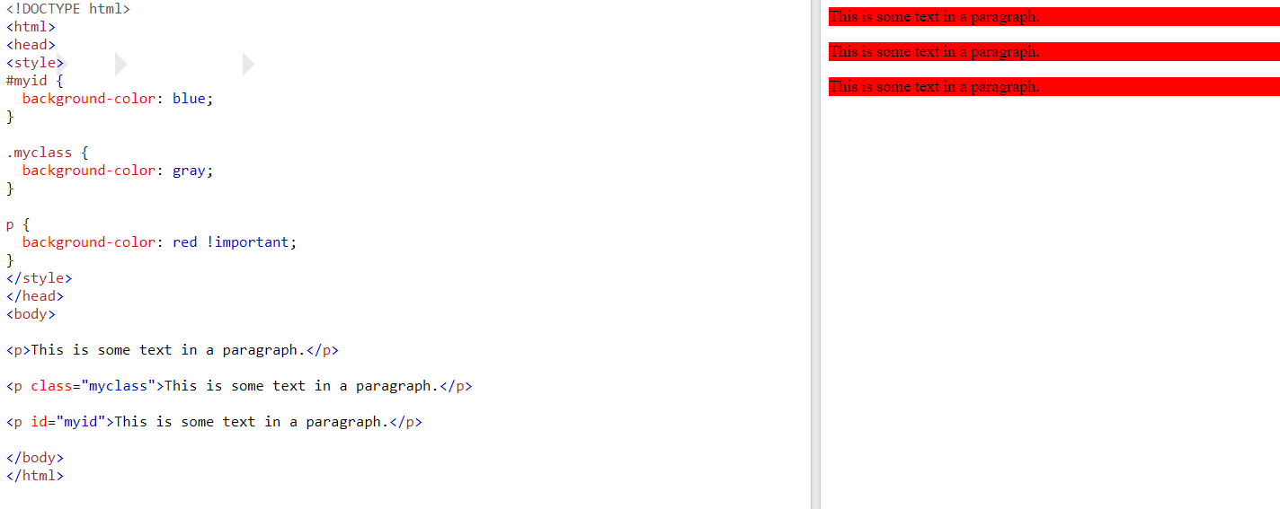
CSS The !important Rule
The !important rule in CSS is used to add more importance to a property/value than normal.
In fact, if you use the !important rule, it will override ALL previous styling rules for that specific property on that element!

Slide 22
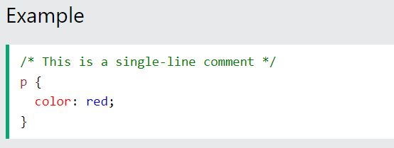
CSS Comments
CSS comments are not displayed in the browser, but they can help document your source code.
Comments are used to explain the code and may help when you edit the source code at a later date.
Comments are ignored by browsers.
A CSS comment is placed inside the <style> element, and starts with /* and ends with */:
We can add comments to your HTML source by using the <!--...--> syntax.

Slide 23
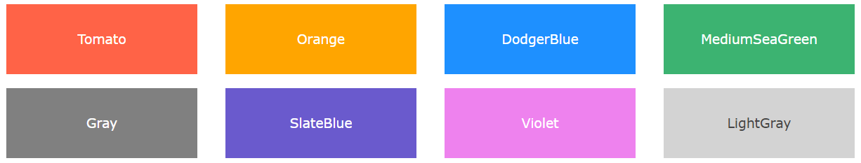
CSS Colors
Colors are specified using predefined color names, or RGB, HEX, HSL, RGBA, HSLA values.
CSS Color Names
In CSS, a color can be specified by using a predefined color name:

Slide 24
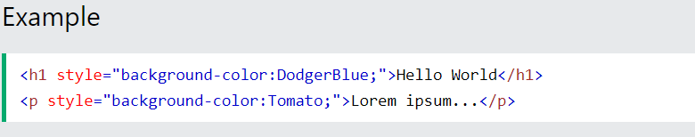
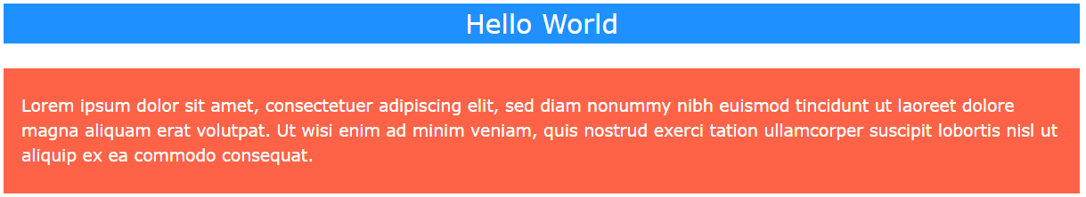
CSS Colors
Colors are specified using predefined color names, or RGB, HEX, HSL, RGBA, HSLA values.
CSS Background Color
You can set the background color for HTML elements:

Slide 25
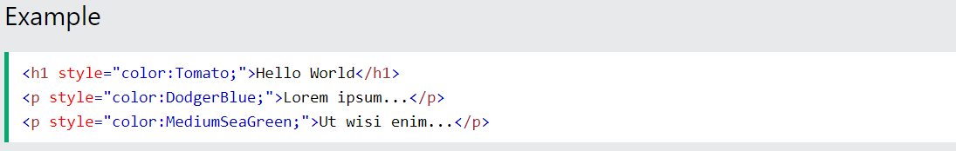
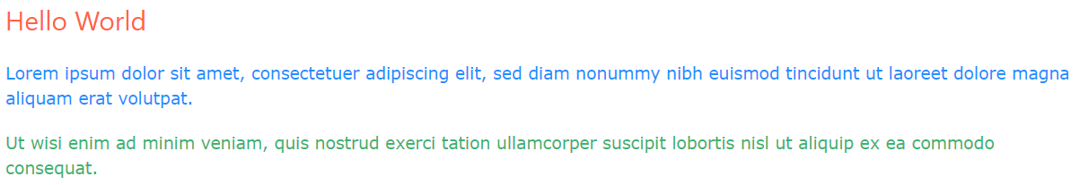
CSS Colors
Colors are specified using predefined color names, or RGB, HEX, HSL, RGBA, HSLA values.
CSS Text Color
You can set the color of text:

Slide 26
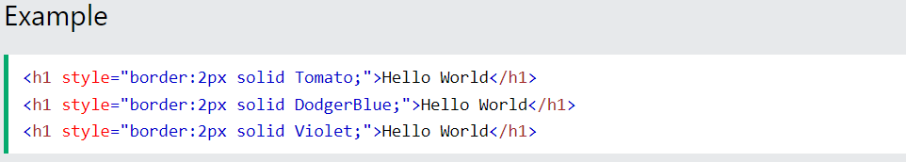
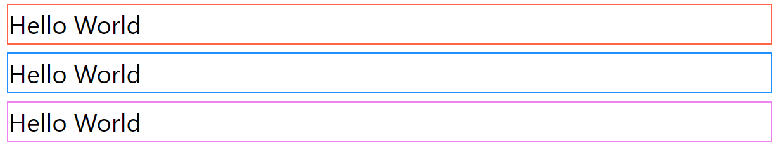
CSS Colors
Colors are specified using predefined color names, or RGB, HEX, HSL, RGBA, HSLA values.
CSS Border Color
You can set the color of borders:

Slide 27
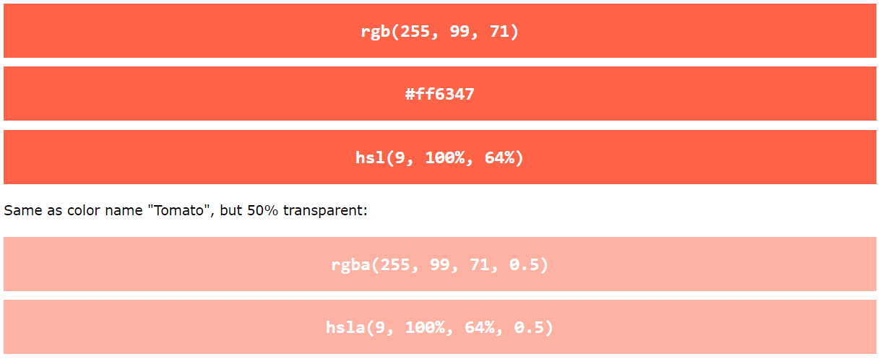
CSS Colors
Colors are specified using predefined color names, or RGB, HEX, HSL, RGBA, HSLA values.
CSS Color Values
In CSS, colors can also be specified using RGB values, HEX values, HSL values, RGBA values, and HSLA values:
Same as color name "Tomato":

Slide 28

CSS Box Model
All HTML elements can be considered as boxes.
In CSS, the term "box model" is used when talking about design and layout.
The CSS box model is essentially a box that wraps around every HTML element.

Slide 29
CSS Box Model
All HTML elements can be considered as boxes.
The box model allows us to add a border around elements, and to define space between elements.
Content - The content of the box, where text and images appear
Padding - Clears an area around the content. The padding is transparent
Border - A border that goes around the padding and content
Margin - Clears an area outside the border. The margin is transparent

Slide 30
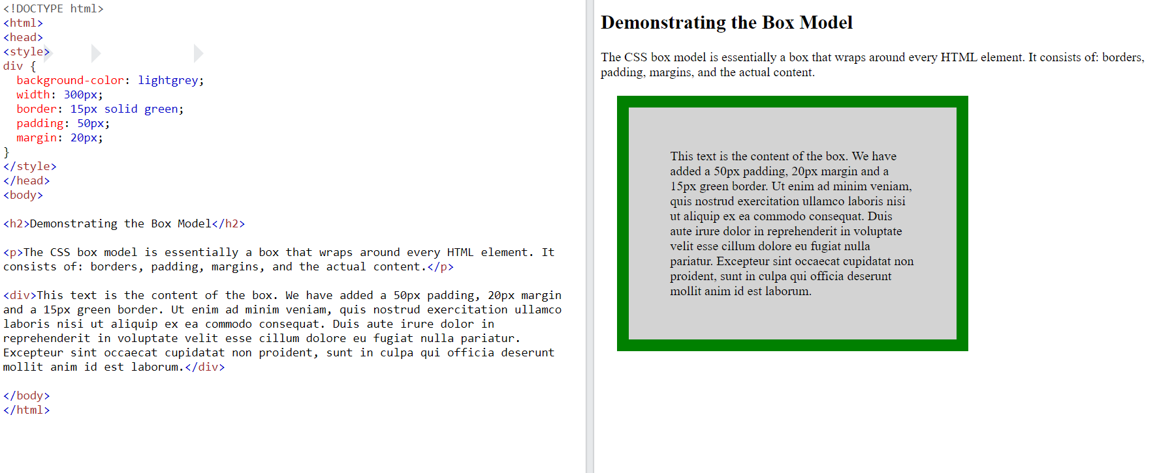
CSS Box Model
All HTML elements can be considered as boxes.

Slide 31
CSS Box Model
All HTML elements can be considered as boxes.
Width and Height of an Element
Total width = width + left padding + right padding + left border + right border + left margin + right margin
Total height = height + top padding + bottom padding + top border + bottom border + top margin + bottom margin

Slide 32
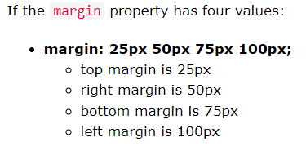
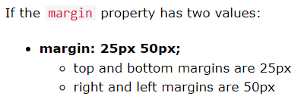
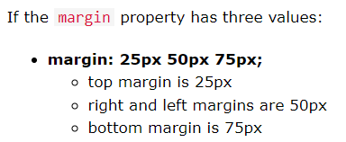
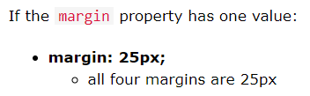
Margin - Shorthand Property
To shorten the code, it is possible to specify all the margin properties in one property.

Slide 33
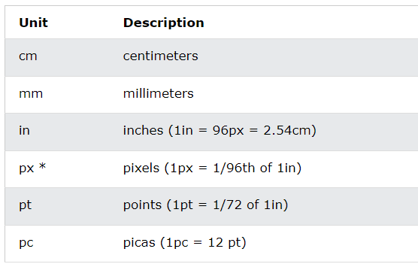
CSS Units
CSS has several different units for expressing a length.
Many CSS properties take "length" values, such as width, margin, padding, font-size, etc.
There are two types of length units: absolute and relative.
Absolute Lengths

Slide 34
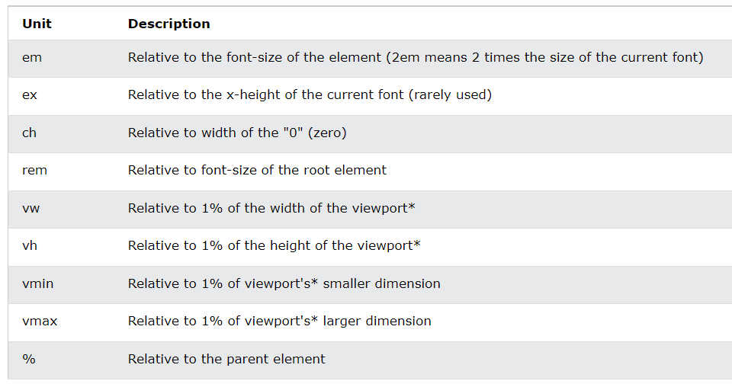
CSS Units
CSS has several different units for expressing a length.
Many CSS properties take "length" values, such as width, margin, padding, font-size, etc.
There are two types of length units: absolute and relative.
Absolute Lengths
Relative Lengths

Slide 35
Summary
Module 03
CSS Basics
use “ids” to target single elements
use “classes” to target groups of elements
use combinations of selector tags to target certain combinations of elements

